Slide 1
Using Mythic & Kali Linux to Simulate Attacks on a Windows Server

Slide 2

Created my Server using Vultr
Phase 1: Server Setup

Slide 3
Installing Mythic into server on Windows PowerShell
Phase 2: Mythic Installation

Slide 4
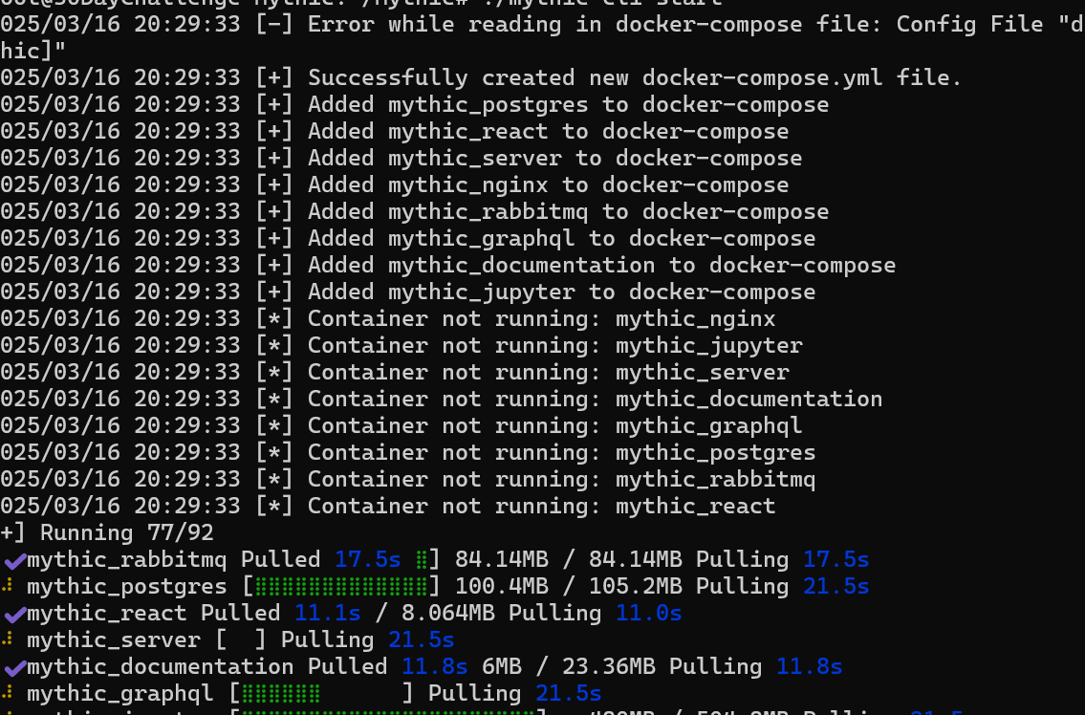
Once Mythic was installed I was able to get into the repository and started to run Mythic

Slide 5
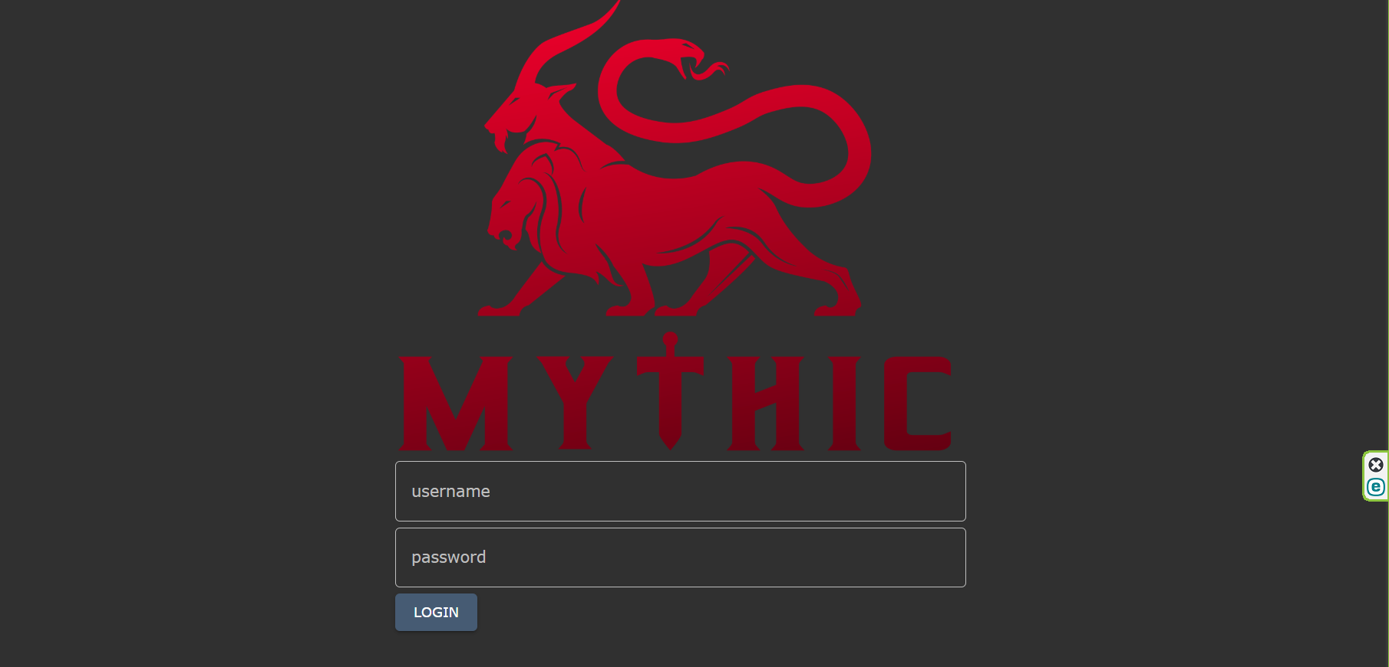
After setting up firewalls in my Mythic Server, I accessed to my Mythic GUI

Slide 6
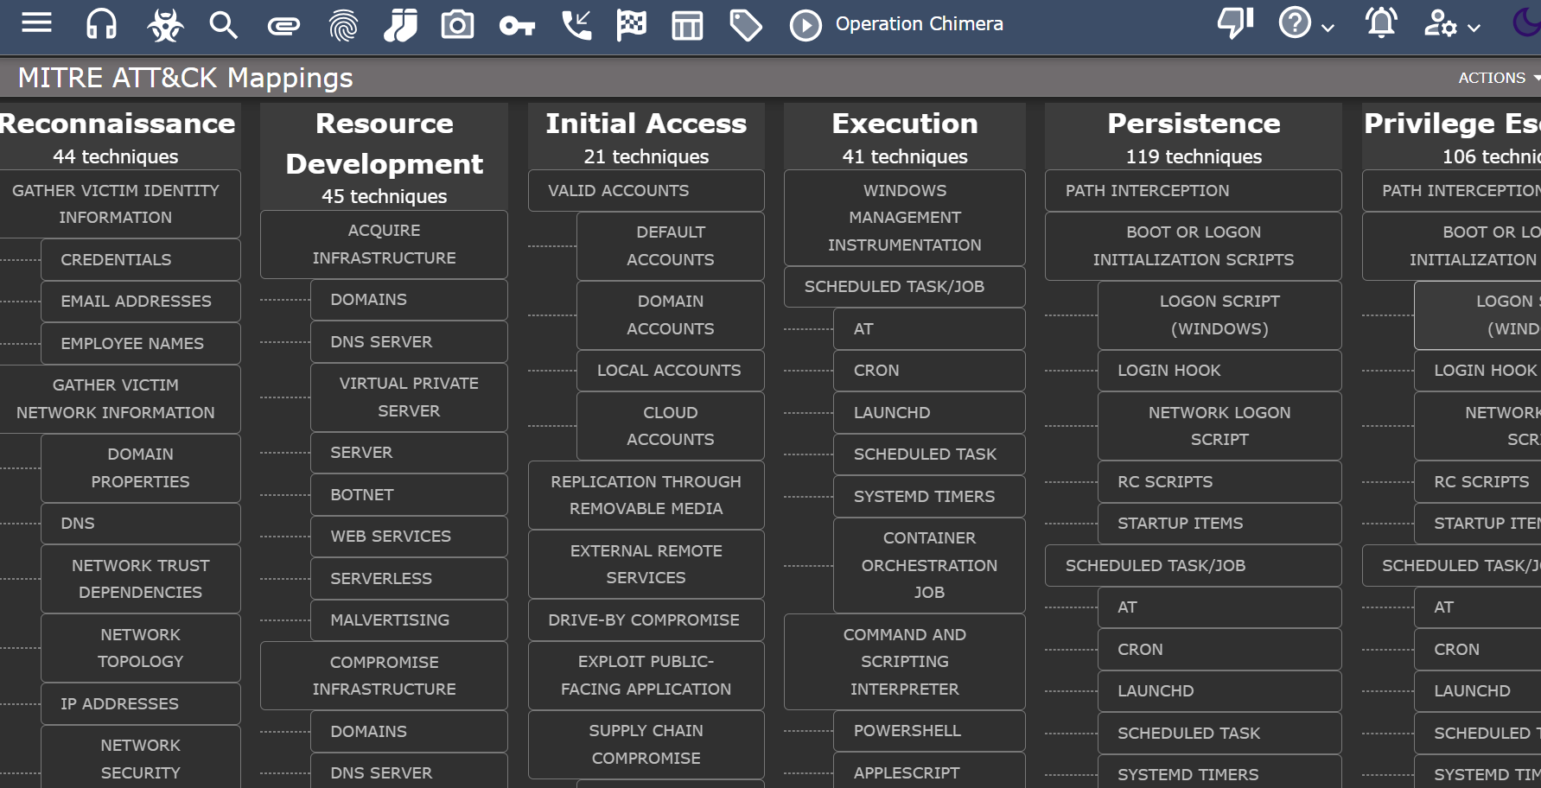
Here I logged in to Mythic and looked at their MITRE ATT&CK Mappings

Slide 7
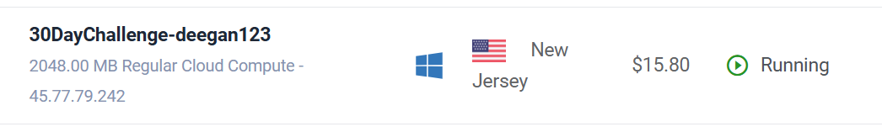
I had already created a Windows server & will be making a fake file called “passwords”

Slide 8
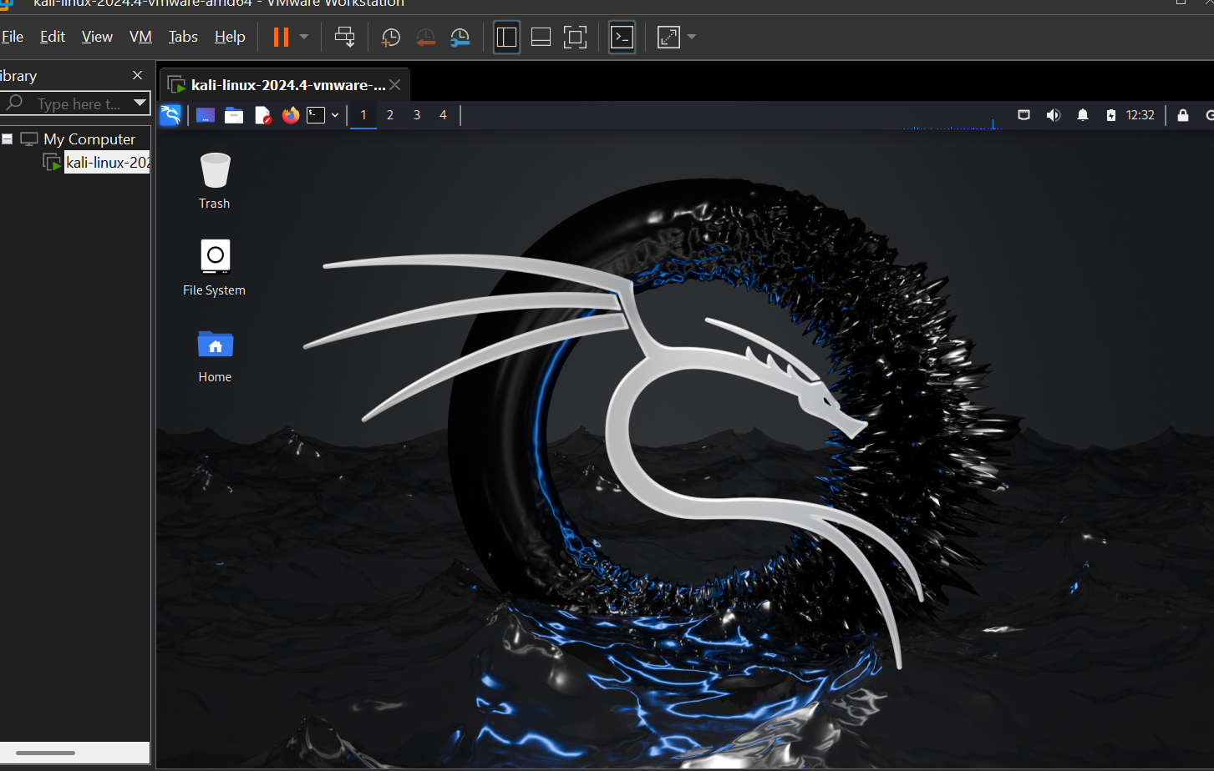
After creating the fake file in my Windows Server, I will begin a RDP Brute Force using Kali Linux
Phase 4: RDP Brute Force

Slide 9
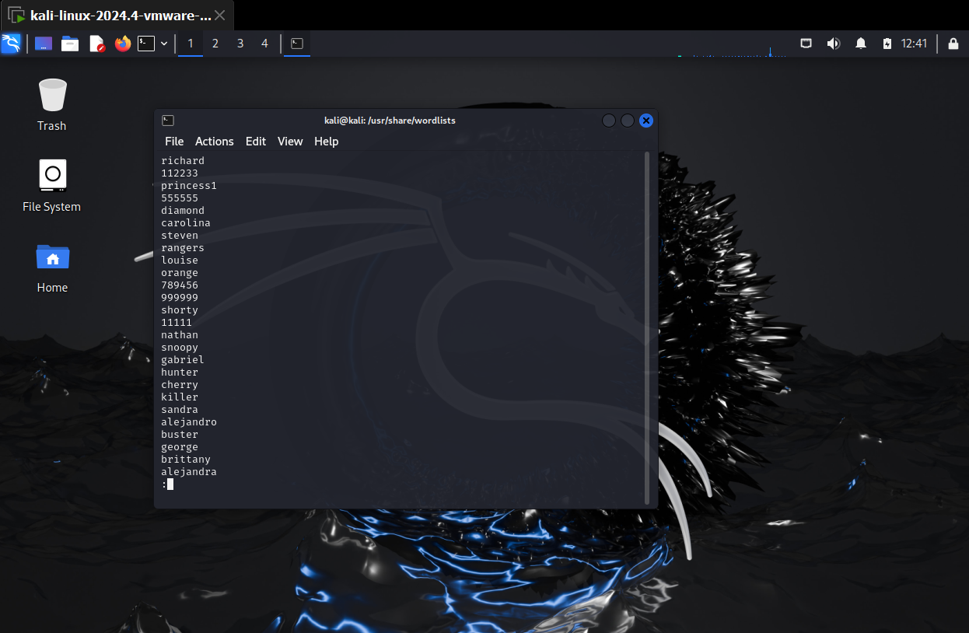
Kali Linux provided a common passwords word list for convenience

Slide 10
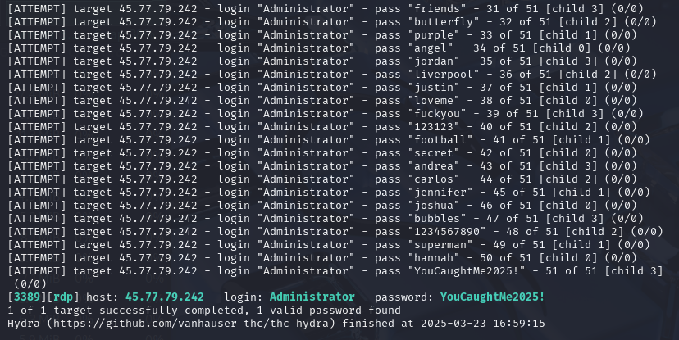
Using Hydra in Kali-Linux I was able to successfully brute force into the Windows server

Slide 11
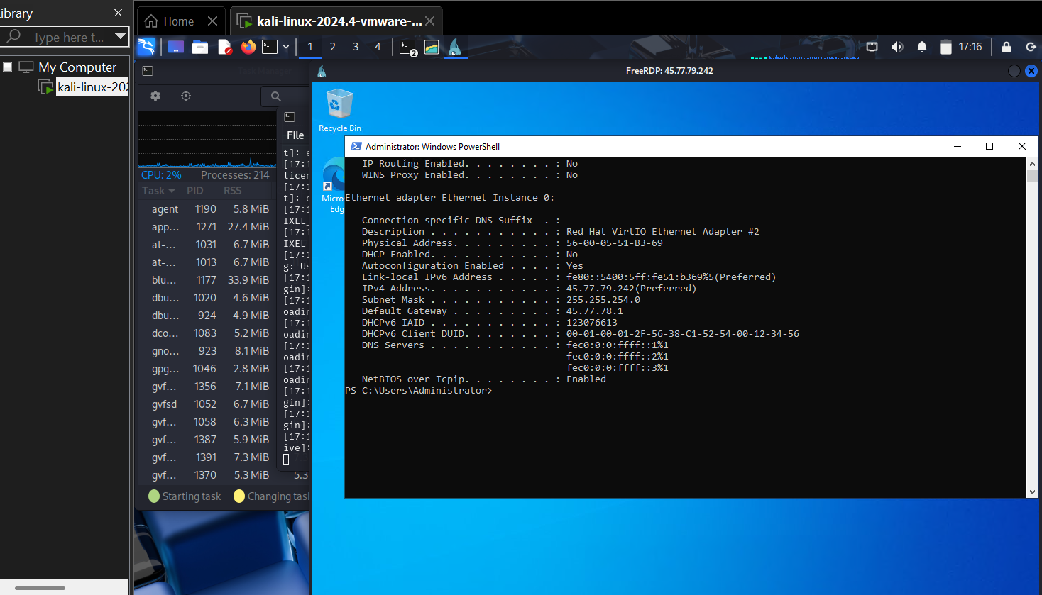
After a successful brute force I was able to RDP into the Windows Server

Slide 12
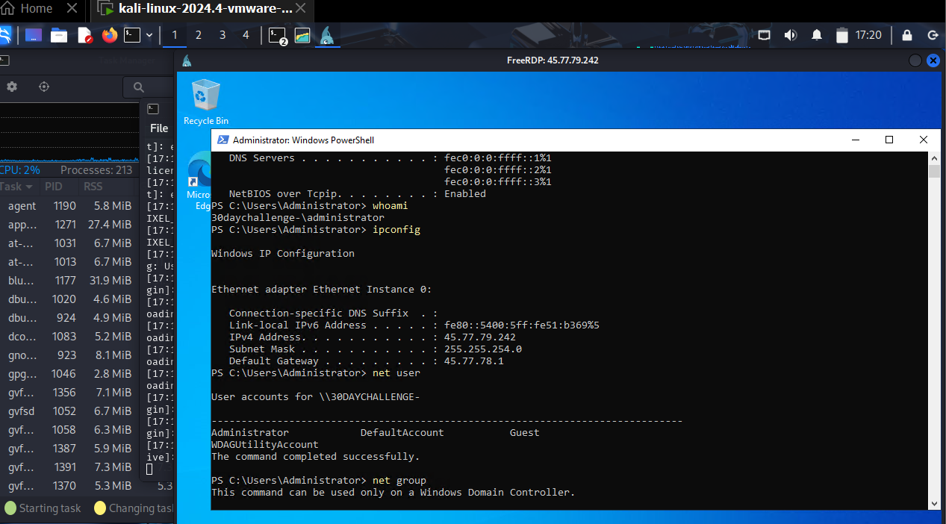
I did some commands such as: whoami, ipconfig, net user & net group

Slide 13
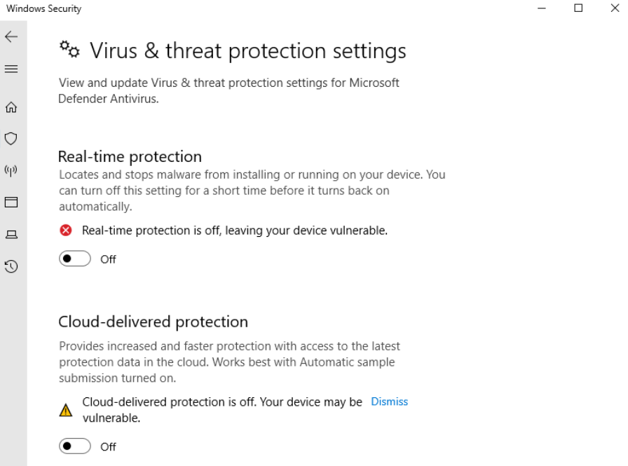
While I was RDP in the Windows server I disabled Windows Defender, for Mythic to run undetected

Slide 14
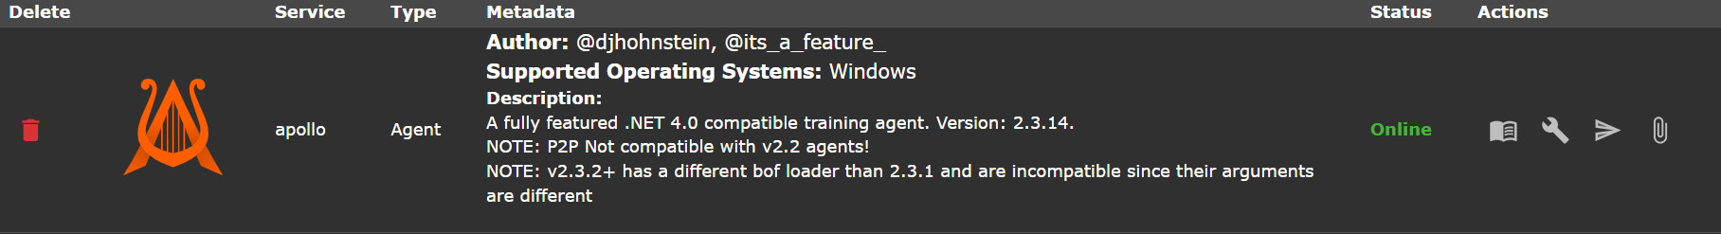
While in my Mythic Gui I downloaded a Mythic Agent to the GUI

Slide 15
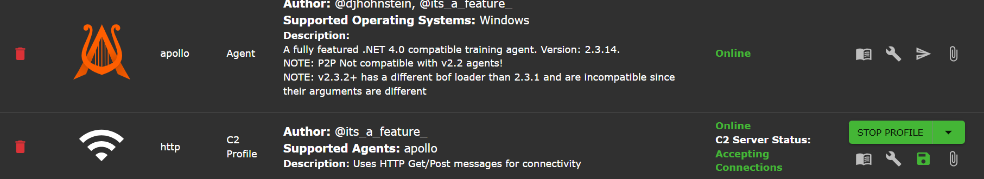
In addition, I set up a C2 profile

Slide 16
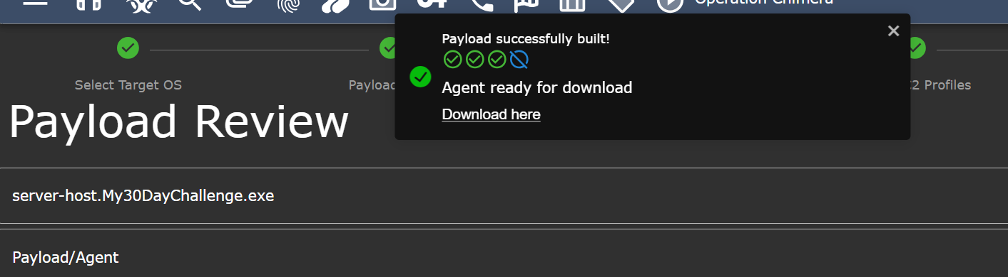
I then also created a payload on Mythic GUI

Slide 17
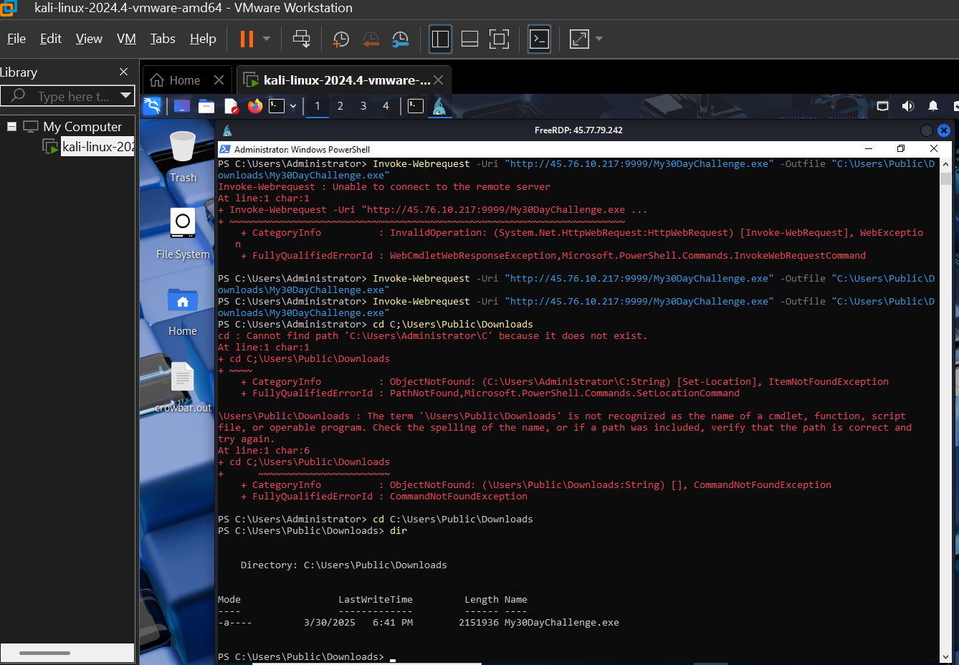
I was able to upload Payload/Agent onto the windows server via Kali RDP
Phase 5: Payload Deployment:

Slide 18
After uploading the payload/agent I got a call back on my Mythic GUI/C2

Slide 19
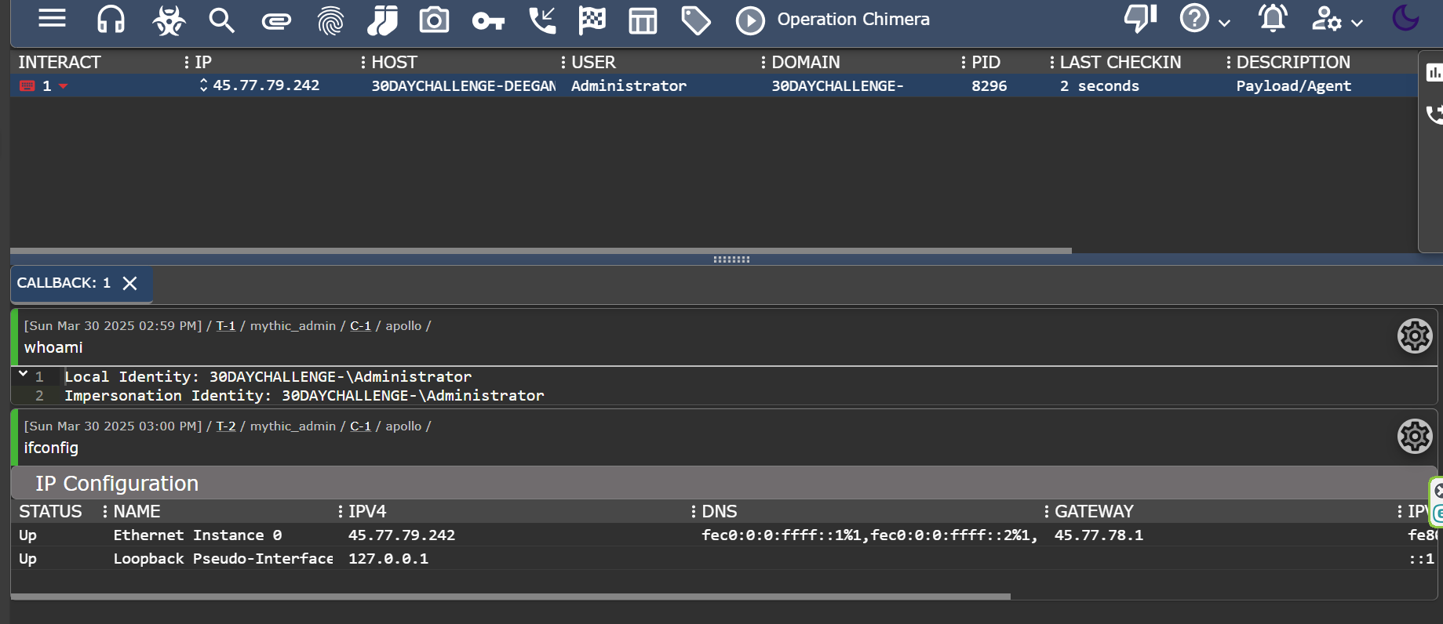
I can run commands through mythic now

Slide 20
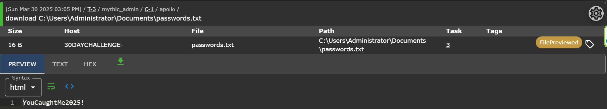
I was able to get the simulated password file

Slide 21
Project Takeaways!
✅ Built and configured a Vultr Windows Server
✅ Installed and managed Mythic C2 on the server
✅ Successfully brute-forced RDP access using Hydra on Kali Linux
✅ Deployed a Mythic agent, created a C2 profile, and established callbacks
✅ Gained remote access and executed live commands via Mythic
✅ Captured a simulated sensitive file (“passwords”)
✅ Demonstrated skills in:
➔ Offensive security
➔ C2 framework operations
➔ RDP brute force attack simulation
➔ Windows system exploitation
➔ Firewall and defense evasion techniques

